Slide 1
MANTIS
Minimalist Alert Network for Threat Intelligence System
Final Dissertation Presentation
Final Dissertation | CSY4022
Anuskar Sigdel | 24812606
Supervisor: Nischal Khadka | University of Northampton | August 2026
Notes:
Use the visible labels as speaking prompts. Explain the point in your own words and then move to the next label.
[Sources]
- MANTIS_Final_Dissertation_FINAL_BACKUP_CURRENT_SAVED_STATE_2026-08-22_160017.docx, relevant chapter and embedded report figures

Slide 2
1. Introduction: Background and Rationale
Why a transparent low-footprint detector is needed on commodity Linux
Scope | Small Linux servers, IoT gateways and teaching hosts
Threats | Scans, floods, malicious payloads and known-bad sources
Gap | Enterprise tools can be heavy; opaque models hide decisions
MANTIS | Five transparent methods with no external Python runtime packages
Explainability | Every alert keeps its feature, threshold or learned-state reason
2
Notes:
Use the visible labels as speaking prompts. Explain the point in your own words and then move to the next label.
[Sources]
- MANTIS_Final_Dissertation_FINAL_BACKUP_CURRENT_SAVED_STATE_2026-08-22_160017.docx, relevant chapter and embedded report figures

Slide 3
2. Aim and Objectives
One aim supported by six measurable and testable objectives
Aim | Build and critically evaluate a transparent, low-footprint host NIDS
Detect | Five complementary engines behind one Verdict contract
Integrate | Live or PCAP capture, parser, bounded queue, alerts and SIEM
Persist | Train supported models and restore compatible JSON brain state
Validate | Separate software correctness from wider field accuracy
Compare | Snort, Suricata, Zeek and Wazuh within stated Linux lab limits
3
Notes:
Use the visible labels as speaking prompts. Explain the point in your own words and then move to the next label.
[Sources]
- MANTIS_Final_Dissertation_FINAL_BACKUP_CURRENT_SAVED_STATE_2026-08-22_160017.docx, relevant chapter and embedded report figures

Slide 4
3. Requirements: Problem and Solutions
Requirement engineering links the problem domain to a justified implementation choice
Engineering option | Why it was considered | Decision for MANTIS
Problem domain | Constrained Linux hosts need explainable monitoring | Five complementary transparent methods
Proposed solution | One compact capture-to-response workflow | Python Standard Library prototype
Snort / Suricata extension | Mature packet inspection | Not selected: shifts work to external engine integration
ML framework | Faster access to complex models | Not selected: adds dependencies and hides first-principles logic
Wazuh deployment | Broad endpoint management and response | Not selected: wider and heavier than the single-host research aim
• The selected strategy is justified for the dissertation aim, not presented as the best choice for every deployment.
4
Notes:
Use the visible labels as speaking prompts. Explain the point in your own words and then move to the next label.
[Sources]
- MANTIS_Final_Dissertation_FINAL_BACKUP_CURRENT_SAVED_STATE_2026-08-22_160017.docx, relevant chapter and embedded report figures

Slide 5
4. Functional and Non-Functional Requirements
Required behaviours are paired with operational qualities and safety constraints
Capture | Live Ethernet or offline PCAP; validate supported protocols
Detect | Run five engines and emit one common Verdict
Evidence | Log, dashboard, SIEM and exportable records
Response | Policy-gated iptables path, disabled by default
Quality | Bounded memory, privacy redaction, reproducibility and safe failure
5
Notes:
Use the visible labels as speaking prompts. Explain the point in your own words and then move to the next label.
[Sources]
- MANTIS_Final_Dissertation_FINAL_BACKUP_CURRENT_SAVED_STATE_2026-08-22_160017.docx, relevant chapter and embedded report figures

Slide 6
Literature Review
Notes:
Use the visible labels as speaking prompts. Explain the point in your own words and then move to the next label.
[Sources]
- MANTIS_Final_Dissertation_FINAL_BACKUP_CURRENT_SAVED_STATE_2026-08-22_160017.docx, relevant chapter and embedded report figures

Slide 7
Literature Review: Recent Evidence
Report papers ordered from newest to oldest
2024 | Halvorsen et al. | Applying Generative Machine Learning to Intrusion Detection: A Systematic Mapping Study and Review
Keywords | generative ML, scarce data, class imbalance, fidelity metrics, deployment gap.
MANTIS link | motivated transparent edge detection with measurable runtime evidence.
2023 | Neto et al. | CICIoT2023: A Real Time Dataset and Benchmark for Large Scale Attacks in IoT Environment
Keywords | 105 IoT devices, 33 attacks, benchmark dataset, schema validation.
MANTIS link | provided external data, while MANTIS validates engine-native features and separates prepared records from raw capture.
7
Notes:
Use the visible labels as speaking prompts. Explain the point in your own words and then move to the next label.
[Sources]
- MANTIS_Final_Dissertation_FINAL_BACKUP_CURRENT_SAVED_STATE_2026-08-22_160017.docx, relevant chapter and embedded report figures

Slide 8
Literature Review: Key Comparisons
The remaining report papers continue in descending year order
2023 | Hidayat et al. | Machine Learning Based Intrusion Detection System: An Experimental Comparison
Keywords | TON_IoT, KNN, model comparison, multiple metrics, computational cost.
MANTIS link | supported a scan-focused KNN engine and per-engine evaluation rather than one universal classifier.
2022 | Kus et al. | A False Sense of Security? Revisiting the State of Machine Learning Based Industrial Intrusion Detection
Keywords | withheld attacks, generalisation failure, inflated random-split accuracy, unknown attacks.
MANTIS link | kept software test passes separate from field accuracy and framed K-Means as novelty detection, not proven zero-day detection.
8
Notes:
Use the visible labels as speaking prompts. Explain the point in your own words and then move to the next label.
[Sources]
- MANTIS_Final_Dissertation_FINAL_BACKUP_CURRENT_SAVED_STATE_2026-08-22_160017.docx, relevant chapter and embedded report figures

Slide 9
5. Methodology
Constructive research builds, evaluates and critiques one traceable artefact
Method | Constructive research: build, evaluate and critique one artefact
Lens | Pragmatism selects evidence suited to each question
Data | Generated frames, matched engine sets, 13,159-frame PCAP and 299,994 external rows
Evidence | Automated tests, metrics, architecture review and usability critique
Reproducibility | Report data origin, preprocessing, configuration and commands
9
Notes:
Use the visible labels as speaking prompts. Explain the point in your own words and then move to the next label.
[Sources]
- MANTIS_Final_Dissertation_FINAL_BACKUP_CURRENT_SAVED_STATE_2026-08-22_160017.docx, relevant chapter and embedded report figures

Slide 10
6. Agile, Scrum and Kanban
How the methodology was implemented during construction
Agile | Incremental build-and-verify cycles
Scrum | Backlog, review and adaptation without claiming a full team
Kanban | Two coding cards and one testing card in progress
Traceability | Each card linked module, requirement, test and evidence
Feedback | Failed evaluation returned work to In Progress
10
Notes:
Use the visible labels as speaking prompts. Explain the point in your own words and then move to the next label.
[Sources]
- MANTIS_Final_Dissertation_FINAL_BACKUP_CURRENT_SAVED_STATE_2026-08-22_160017.docx, relevant chapter and embedded report figures

Slide 11
7. Algorithm Definitions and Roles
Each method targets a different observable threat pattern
Engine | Definition | Used for | MANTIS input
Z-Score | Deviation from an online mean | Volumetric flood anomaly | Packets per second
KNN | Vote of nearest labelled vectors | Port-scan behaviour | Packet count and unique ports
Naive Bayes | Token class probability | Malicious plaintext payload | Privacy-limited tokens
K-Means | Distance from learned centroids | Behavioural novelty | PPS and unique ports
Bloom Filter | Probabilistic set membership | Known-bad source reputation | Source IP
• Five distinct decision methods feed one common Verdict contract.
11
Notes:
Use the visible labels as speaking prompts. Explain the point in your own words and then move to the next label.
[Sources]
- MANTIS_Final_Dissertation_FINAL_BACKUP_CURRENT_SAVED_STATE_2026-08-22_160017.docx, relevant chapter and embedded report figures

Slide 12
8. Engine Implementation
Definitions become explicit state, calculations and decision rules in the system
Engine | Implementation | Stored state | Decision rule
Z-Score | Welford online mean and variance | Count, mean and M2 | Alert when |z| > 3 after warm-up
KNN | Scaled Euclidean distance and k=3 vote | Labelled vectors | Majority label plus vote confidence
Naive Bayes | Token priors and smoothed likelihoods | Class and token counts | Malicious class above threshold
K-Means | Online mini-batch centroid update | Centroids and counts | Distance threshold; anomalies withheld
Bloom Filter | Fixed bit array with multiple hashes | Bits and feed metadata | Membership hit for source IP
Training and compatible state are exported to a readable JSON brain and restored at startup.
12
Notes:
Use the visible labels as speaking prompts. Explain the point in your own words and then move to the next label.
[Sources]
- MANTIS_Final_Dissertation_FINAL_BACKUP_CURRENT_SAVED_STATE_2026-08-22_160017.docx, relevant chapter and embedded report figures

Slide 13
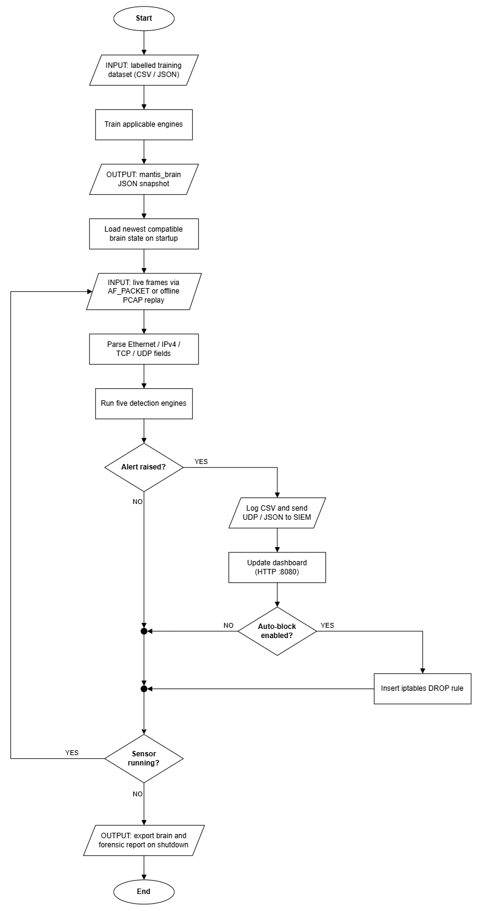
9. System Analysis: Workflow
Capture, detection, evidence and optional response operate as one bounded path
Train | Validate labelled records and export compatible brain state
Capture | AF_PACKET live traffic or controlled PCAP replay
Analyse | Parser validates; five engines return Verdict objects
Respond | Dispatcher logs, SIEM, dashboard and optional policy-gated blocking
Persist | Shutdown exports state and a forensic report
13
Notes:
Use the visible labels as speaking prompts. Explain the point in your own words and then move to the next label.
[Sources]
- MANTIS_Final_Dissertation_FINAL_BACKUP_CURRENT_SAVED_STATE_2026-08-22_160017.docx, relevant chapter and embedded report figures

Slide 14
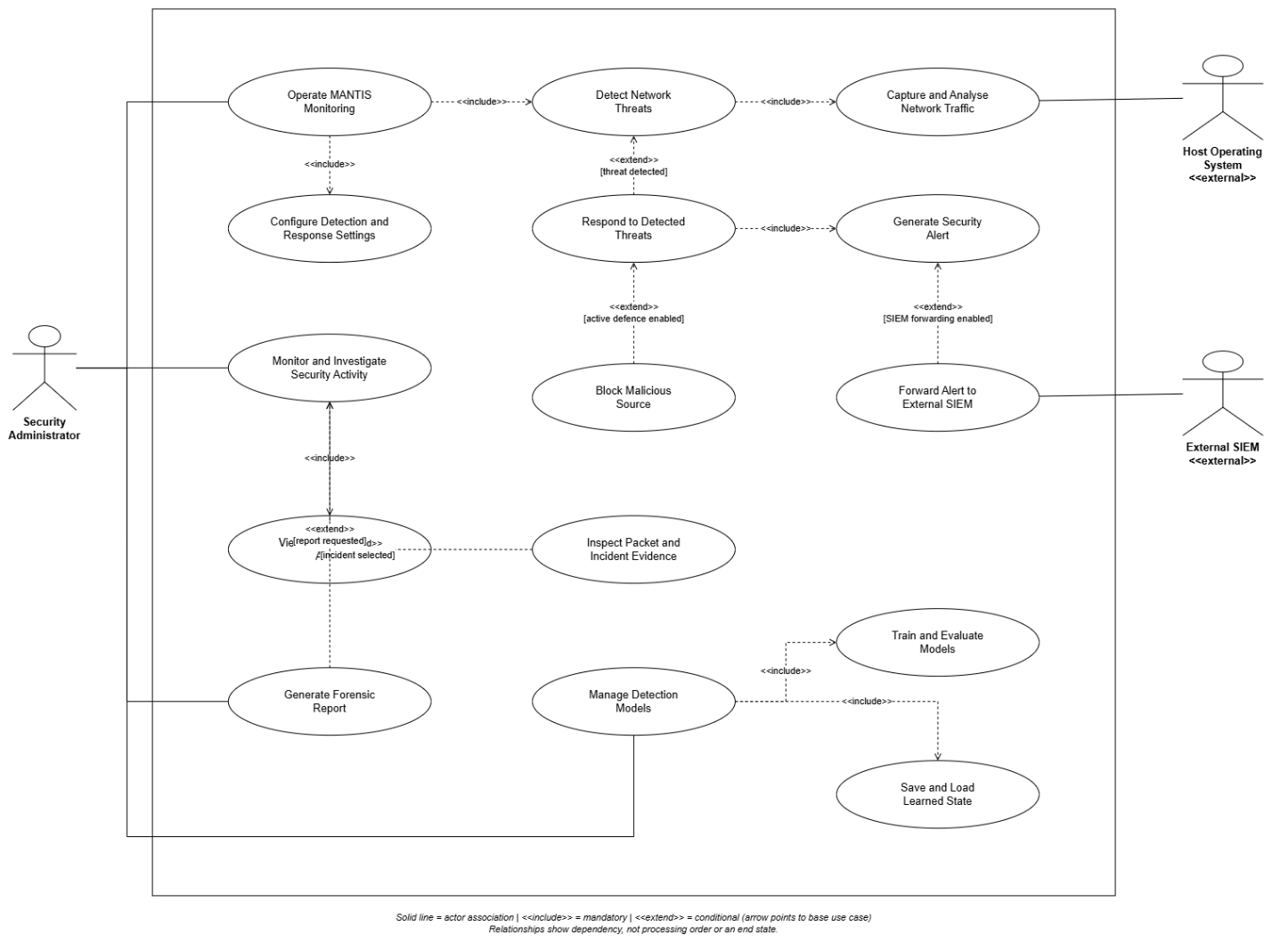
10. System Design: Use Cases
Key points: administrator | host OS | SIEM | mandatory monitoring | conditional defence
14
Notes:
Use the visible labels as speaking prompts. Explain the point in your own words and then move to the next label.
[Sources]
- MANTIS_Final_Dissertation_FINAL_BACKUP_CURRENT_SAVED_STATE_2026-08-22_160017.docx, relevant chapter and embedded report figures

Slide 15
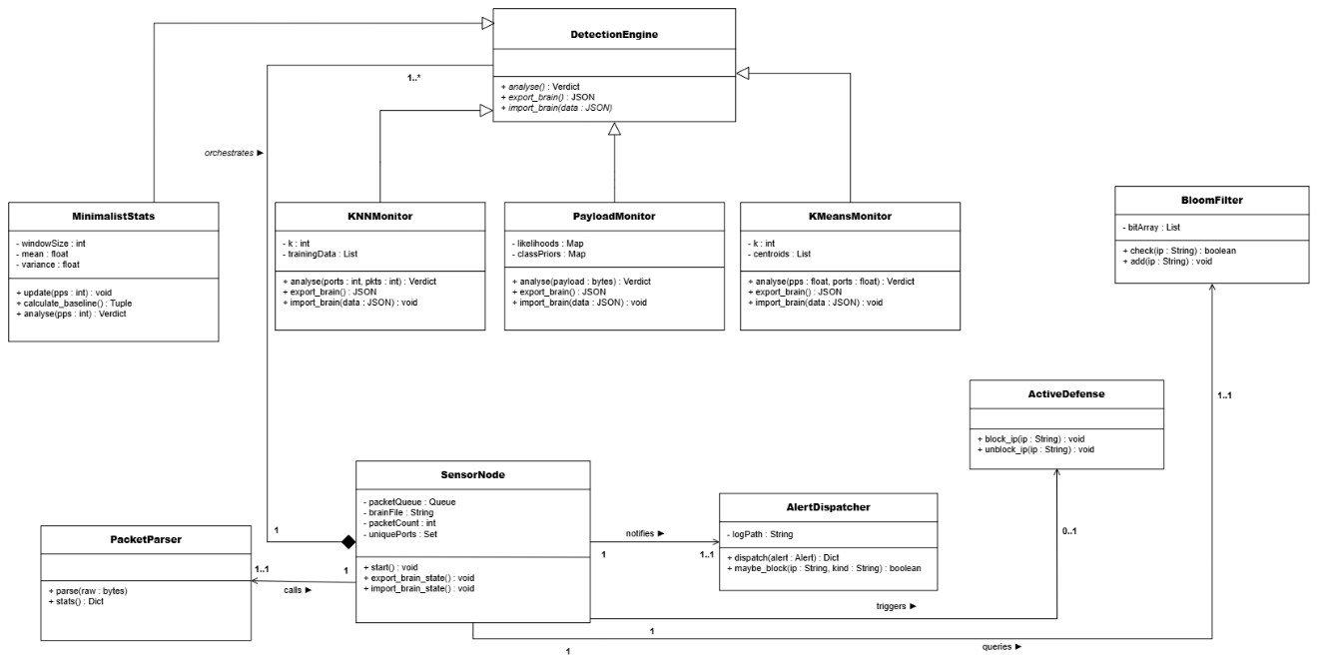
11. System Design: Class Model
Key points: SensorNode ownership | common engine contract | optional response | exact multiplicities
15
Notes:
Use the visible labels as speaking prompts. Explain the point in your own words and then move to the next label.
[Sources]
- MANTIS_Final_Dissertation_FINAL_BACKUP_CURRENT_SAVED_STATE_2026-08-22_160017.docx, relevant chapter and embedded report figures

Slide 16
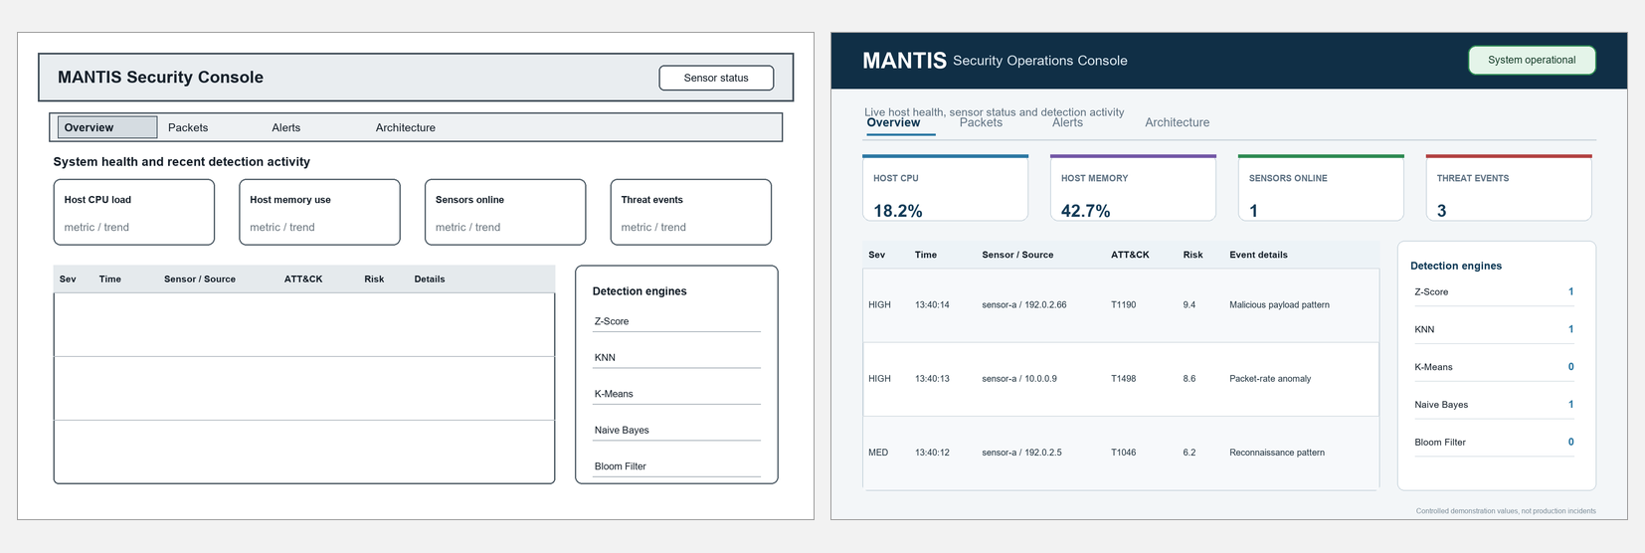
Interface Design: Overview
Demo anchors: CPU | memory | sensors online | threat events | engine activity
16
Notes:
DEMO: OVERVIEW TAB
1. Start the dashboard and say that this page is the one-screen operational summary. It refreshes approximately once per second.
2. CPU load is whole-host Linux CPU usage, not only the MANTIS process. The dashboard reads the first CPU line in /proc/stat, compares total and idle counters with the previous reading, and calculates busy time as a percentage of the elapsed total. A brief spike means the host was busy during that refresh interval.
3. Memory is also whole-host usage. It reads MemTotal and MemAvailable from /proc/meminfo and calculates (MemTotal minus MemAvailable) divided by MemTotal. Do not present this card as MANTIS-only RAM usage. If the examiner asks for MANTIS process overhead, use ps with PID, percent CPU, RSS, elapsed time and command; RSS is reported in KiB and can be divided by 1024 for MiB.
4. Sensors Online counts sensor IP addresses whose most recent alert telemetry arrived within the last 60 seconds. It may show zero before the first alert because ordinary packets do not update that alert-based last-seen map.
5. Threat Events is the number of alerts currently retained by the dashboard. The in-memory history is bounded to the newest 100 alerts, so this is not a lifetime counter and not a count of unique attackers.
6. The report mock-up visually lists all five engines. In the current live stats endpoint, however, the dedicated counters are message-based DDoS, SCAN, PAYLOAD and BLACKLIST categories. K-Means anomalies can still appear in the event list, but they are not exposed as a separate live counter. State this mock-up-versus-implementation difference honestly if it appears during the demo.
7. While demonstrating, create or replay a safe prepared event, point to the changed card and recent-event row, then explain that the same structured event can be inspected on the Alerts tab. If live traffic is quiet, use the prepared PCAP or JSON evidence rather than waiting.
Suggested wording: This dashboard is an operator summary. CPU and memory describe the whole host, sensor status is based on recent alert telemetry, and the event cards summarize the bounded alert history.
[Sources]
- MANTIS_Final_Dissertation_FINAL_BACKUP_CURRENT_SAVED_STATE_2026-08-22_160017.docx, Section 3.7, Figures 3.7a and 3.8a
- src/dashboard_ui/siem.py, read_cpu_percent, read_mem_percent, api_stats and dashboard refresh logic
- TEST_GUIDE.md, process-level resource measurement guidance

Slide 17
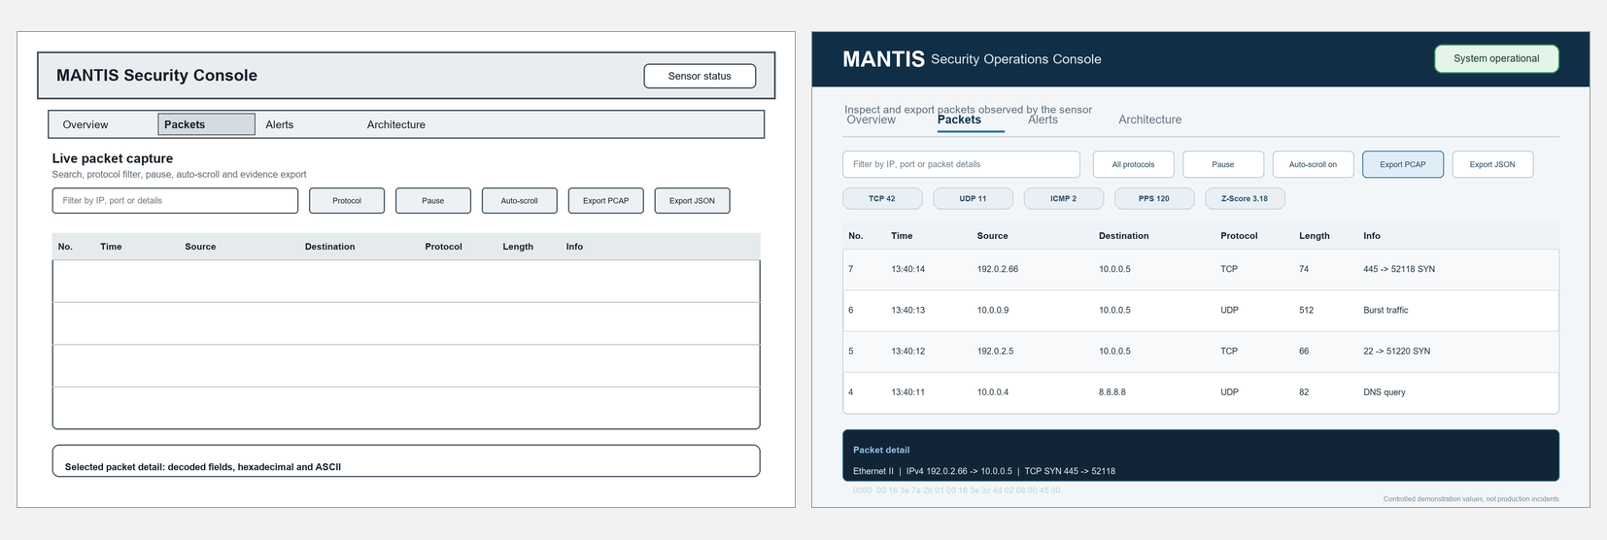
Interface Design: Packets
Demo anchors: filters | protocol counts | PPS and Z-Score | packet detail | PCAP or JSON export
17
Notes:
DEMO: PACKETS TAB
1. Explain that this tab is for packet evidence and traffic context, while the Alerts tab is for security decisions.
2. The packet table uses a bounded ring buffer. Its default maximum is 5,000 packet records; when full, the oldest record is discarded automatically. This limits memory growth.
3. PPS means packets per second for the most recent measurement interval. In the sensor loop, packet_count is accumulated and, roughly once per second, becomes the displayed PPS before the interval counters are reset.
4. The baseline mean and Z-Score come from the online Z-Score engine. The score expresses how far current PPS is from its learned normal level in standard-deviation units after warm-up. It is evidence for the decision, not a probability.
5. Protocol counts and total_seen are cumulative for the current process session. The buffered value is only the current capped ring-buffer length, so total_seen can keep increasing after buffered reaches 5,000.
6. Use filters to isolate a protocol, source, destination or time of interest. Pause and auto-scroll change how the operator views the table; they do not stop packet capture or detection.
7. Open one row and explain the metadata, bounded hexadecimal view and ASCII view. Then show that evidence can be exported as PCAP or JSON for later investigation.
Suggested wording: Here I move from summary metrics to packet-level evidence. PPS and Z-Score describe the current interval, cumulative counters describe the session, and the bounded buffer keeps only recent inspectable records.
[Sources]
- MANTIS_Final_Dissertation_FINAL_BACKUP_CURRENT_SAVED_STATE_2026-08-22_160017.docx, Section 3.7, Figures 3.7b and 3.8b
- src/utils/packet_store.py, bounded deque, interval statistics, detail view and exports
- src/sensor_node/sensor.py, one-second PPS and feature interval

Slide 18
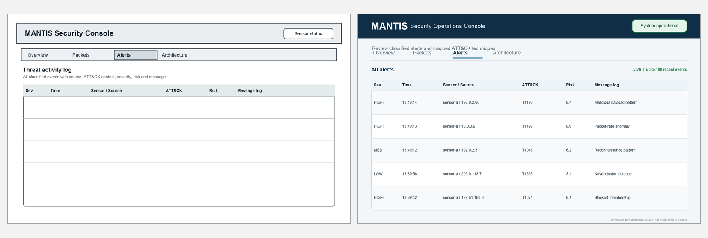
Interface Design: Alerts
Demo anchors: severity | time | sensor and source | ATT&CK | risk | decision message
18
Notes:
DEMO: ALERTS TAB
1. Select an alert and explain it from left to right: severity, dashboard receive time, sensor identity, detected source, ATT&CK context, risk score and the human-readable decision message.
2. The sensor sends structured JSON through UDP port 9999. The dashboard records the receive time and telemetry sender, then places the newest event first in a history capped at 100 items.
3. Sensor and source are different. Sensor is the host that sent the telemetry; source is the network address identified in the detected packet or event.
4. The dispatcher enriches each detection with a kind, MITRE ATT&CK tactic and technique, severity, engine and risk. The message preserves the visible feature or rule that caused the decision so the operator can challenge it.
5. Risk is not a probability of attack. It starts from the technique base score, is adjusted by confidence using base score multiplied by (0.7 plus 0.3 times confidence), and is clamped to 0 through 10. If confidence is absent, the base score is used.
6. Show how severity or text filters reduce the list, then open one message and connect its wording to the responsible engine. For example, a scan alert should mention source behaviour and port diversity; a payload alert should name the payload decision rather than hide it behind a generic score.
Suggested wording: The important part is traceability. I can identify which sensor reported the event, which source was detected, which engine decided it, the ATT&CK context and the exact decision evidence.
[Sources]
- MANTIS_Final_Dissertation_FINAL_BACKUP_CURRENT_SAVED_STATE_2026-08-22_160017.docx, Section 3.7, Figures 3.7c and 3.8c
- src/alert_dispatcher/dispatcher.py and src/utils/logger.py, structured telemetry and alert flow
- src/utils/mitre.py, ATT&CK enrichment, severity and risk calculation
- src/dashboard_ui/siem.py, UDP ingestion and bounded alert history

Slide 19
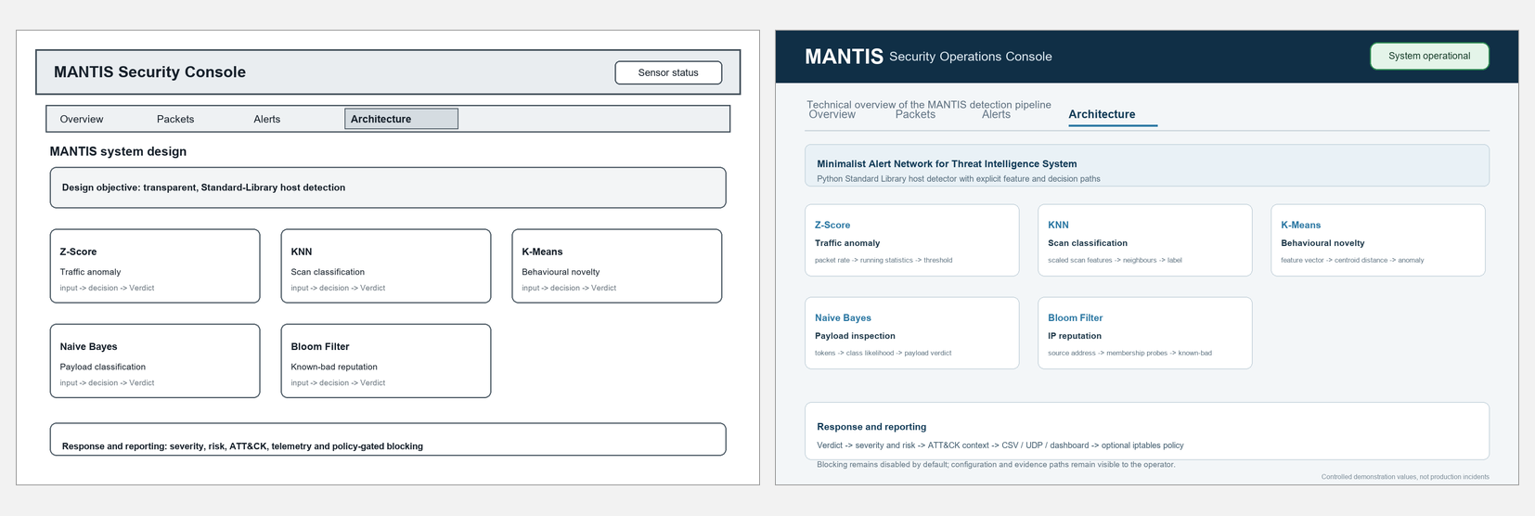
Architecture Interface
Demo anchors: five engines | one Verdict | evidence path | policy-gated response
19
Notes:
DEMO: ARCHITECTURE TAB AND END-TO-END FLOW
1. Begin at capture. MANTIS receives live Ethernet frames through AF_PACKET or reads a controlled PCAP file.
2. The parser validates supported protocol fields and converts raw frames into features. Malformed input is handled safely instead of terminating the analysis loop.
3. Five engines examine complementary evidence: Z-Score for rate deviation, KNN for labelled traffic shape, Naive Bayes for payload tokens, K-Means for novelty distance and Bloom Filter for known-bad membership.
4. Each engine returns the same Verdict contract. The engines do not write directly to the dashboard and do not change the firewall. The dispatcher is the controlled integration point.
5. The dispatcher creates evidence for logs, UDP SIEM telemetry, dashboard display and the forensic report. This separation keeps detection, evidence and response auditable.
6. Active response is optional and disabled by default. A source can be blocked only when blocking is enabled, the detection kind is allowed by policy and the source is not whitelisted. This means an alert does not automatically prove that a firewall rule was inserted.
7. Finish the demo by returning to Overview and showing the same event at summary level. If the live environment fails, replay the prepared PCAP and use saved JSON evidence. This still demonstrates the real code path without attacking an external network.
Suggested wording: The architecture separates capture, decision, evidence and response. Five transparent engines share one Verdict contract, the dispatcher centralizes outputs, and defence remains an explicit policy decision.
[Sources]
- MANTIS_Final_Dissertation_FINAL_BACKUP_CURRENT_SAVED_STATE_2026-08-22_160017.docx, Sections 3.5 to 3.7, Figures 3.7d and 3.8d
- src/sensor_node/sensor.py, capture, parser, engine calls and interval features
- src/alert_dispatcher/dispatcher.py, common evidence pipeline and optional response
- src/active_defense/defense.py and configuration, policy-gated blocking

Slide 20
Testing 1: Strategy and Unit Tests
Testing verifies specified behaviour before evaluation interprets accuracy
Strategy | Unit, integration, system, regression and training checks
Final run | 116 tests passed in 4.642 seconds on 20 August 2026
Unit focus | Engine mathematics, parser rules, configuration, privacy and persistence
Cases | Positive, negative, boundary, malformed-input and safe-failure behaviour
Repeatability | Generated frames and PCAPs avoid attacking external networks
20
Notes:
Use the visible labels as speaking prompts. Explain the point in your own words and then move to the next label.
[Sources]
- MANTIS_Final_Dissertation_FINAL_BACKUP_CURRENT_SAVED_STATE_2026-08-22_160017.docx, relevant chapter and embedded report figures

Slide 21
Testing 2: Integration Checks
Internal white-box paths and external black-box behaviour
Integration | Parser to engines to Verdict to dispatcher to outputs
White-box | Scaling, deduplication, redaction and policy branches
Black-box | CLI, UDP 9999, HTTP 8080, malformed datagrams and exports
System | Real services bind to loopback during tests
Safety | Recording defence verifies policy without changing the firewall
21
Notes:
Use the visible labels as speaking prompts. Explain the point in your own words and then move to the next label.
[Sources]
- MANTIS_Final_Dissertation_FINAL_BACKUP_CURRENT_SAVED_STATE_2026-08-22_160017.docx, relevant chapter and embedded report figures

Slide 22
Testing 3: Algorithm-Specific Checks
Each engine is tested according to its own state and failure modes
Z-Score | Warm-up, sustained flood and poisoning protection
KNN | Scaling, normal traffic and flood-versus-scan separation
K-Means | Familiar traffic, novelty distance and withheld anomaly updates
Naive Bayes | Benign, malicious and ADMIN safeguard tokens
Bloom Filter | Loading, saturation and no false negatives for inserted indicators
22
Notes:
Use the visible labels as speaking prompts. Explain the point in your own words and then move to the next label.
[Sources]
- MANTIS_Final_Dissertation_FINAL_BACKUP_CURRENT_SAVED_STATE_2026-08-22_160017.docx, relevant chapter and embedded report figures

Slide 23
Results: Algorithm Accuracy
Small domain-matched sets verify implementation, not unrestricted field accuracy
Engine | Samples | Precision | Recall | F1 | MCC
KNN port scan | 40 | 1.0000 | 1.0000 | 1.0000 | 1.0000
Naive Bayes payload | 24 | 1.0000 | 0.9167 | 0.9565 | 0.9199
Z-Score flood | 40 | 1.0000 | 1.0000 | 1.0000 | 1.0000
K-Means novelty | 44 | 1.0000 | 1.0000 | 1.0000 | 1.0000
Bloom reputation | 25 | 1.0000 | 1.0000 | 1.0000 | 1.0000
Naive Bayes missed one of twelve malicious payloads; the other engines were perfect on their small matched samples.
Scores are not directly comparable because each engine uses a separate dataset and decision problem.
23
Notes:
Use the visible labels as speaking prompts. Explain the point in your own words and then move to the next label.
[Sources]
- MANTIS_Final_Dissertation_FINAL_BACKUP_CURRENT_SAVED_STATE_2026-08-22_160017.docx, relevant chapter and embedded report figures

Slide 24
Results: Dataset Findings
Dataset scale and class balance change how accuracy evidence should be interpreted
Evidence | Size | Key result | Meaning | Limit | Report source
Automated suite | 116 tests | 100% pass | Software behaviour | UDP socket warnings | Chapter 5
Matched engine sets | 173 samples | F1 0.9565 to 1.0000 | Implementation checks | Small separate sets | Table 5.2
PCAP scenario | 13,159 frames | All engines fire | End-to-end replay | Controlled scenario | Abstract
CIC-IoT2023 review | 299,994 rows | Prevalence 0.9761 | Severe imbalance | Not raw packet features | Abstract
Always-positive | Same rows | F1 0.9879 | Headline F1 misleads | Trivial baseline | Abstract
• Heavy-tailed rates violate a fixed three-sigma assumption; the report separates verified implementation from production-accuracy claims.
24
Notes:
Use the visible labels as speaking prompts. Explain the point in your own words and then move to the next label.
[Sources]
- MANTIS_Final_Dissertation_FINAL_BACKUP_CURRENT_SAVED_STATE_2026-08-22_160017.docx, relevant chapter and embedded report figures

Slide 25
Conclusion
Contribution | Five transparent engines in one inspectable workflow
Evidence | 116 tests, matched metrics, controlled replay and external-data critique
Safety | Bounded storage, privacy controls and policy-gated response
Limitation | Laboratory evidence does not prove unrestricted field accuracy
Future work | Independent balanced evaluation, authenticated telemetry and IPv6
Transparent implementation, traceable testing, honest evidence
25
Notes:
Use the visible labels as speaking prompts. Explain the point in your own words and then move to the next label.
[Sources]
- MANTIS_Final_Dissertation_FINAL_BACKUP_CURRENT_SAVED_STATE_2026-08-22_160017.docx, relevant chapter and embedded report figures

